Slide 1
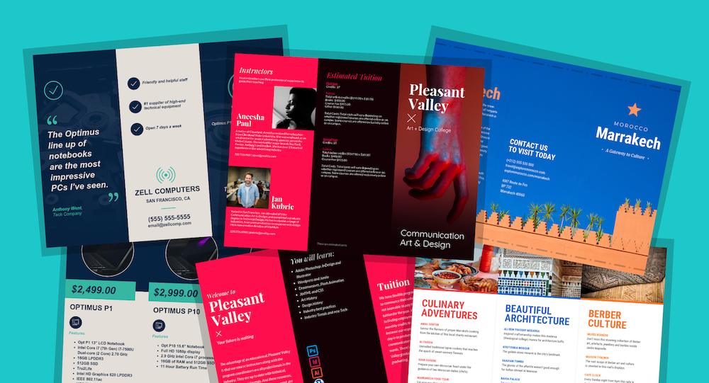
By Swagata Katiyar (36115603118)
ANDROID APP DEVELOPMENT
Online Brochure Order System

Slide 2
INTRODUCTION
“Brochureordersystem.apk" is an user friendly interface that gives you an efficient way to collect orders regarding brochures both on official and non- official level.
It collects details from customers, stores it in an database and updates the customer about their delivery.
Promotes integration of current technologies like Google Calendar, Google Map, Browser,etc.
Collectively, provides the customers with the easy and efficient way of ordering and saving their time and efforts.

Slide 3
Existing System And Comparison
EXISTING SYSTEM
PROPOSED SYSTEM
Limited visualization of design
Long Queues
No Comparison
Waste of energy and efforts
Limited to shopping hours
Collecting from store itself
Proper visualization
Avoids Queues
Ease of Comparison
Energy and resources are saved
24 x 7 with No restrictions
Door step delivery

Slide 4


Slide 5
SOFTWARE REQUIREMENTS:
Android Studio
Xamp Server
PhpMyAdmin
Postman
Sublime Text Editor

Slide 6
LANGUAGES USED:
JAVA- The Android platform allows developers to write managed code using Java to manage and control the Android device.
XML- Using Android's XML, you can quickly design UI layouts and the screen elements they contain
PHP & MYSQL- MYSQL is used as a database language at the webserver and PHP is used to. fetch data from the database

Slide 7
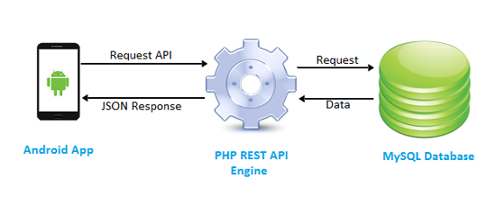
WORKING

Slide 8

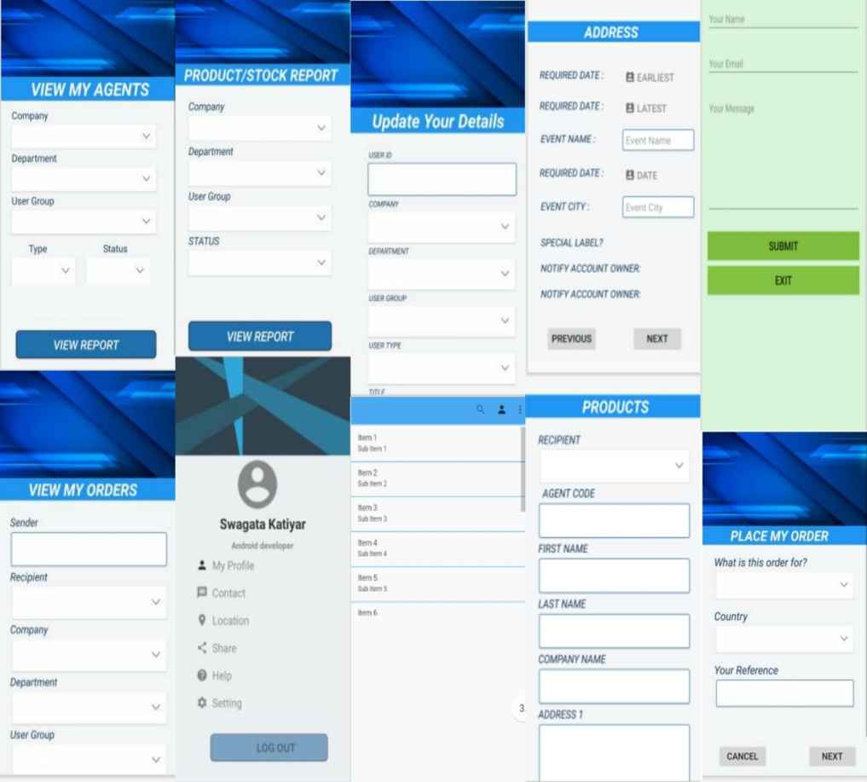
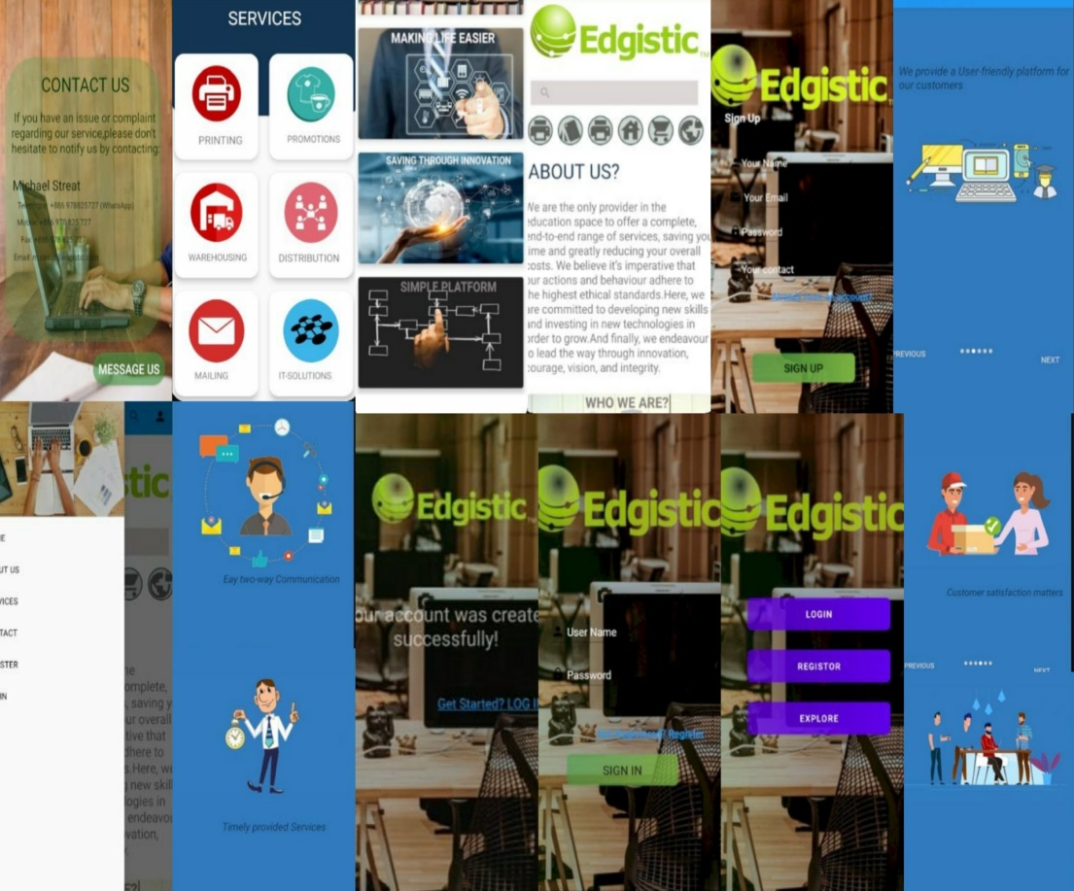
UI / UX DESIGNS

Slide 9
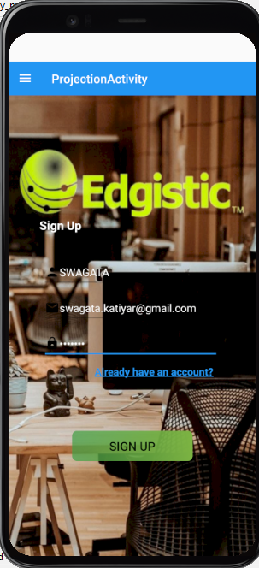
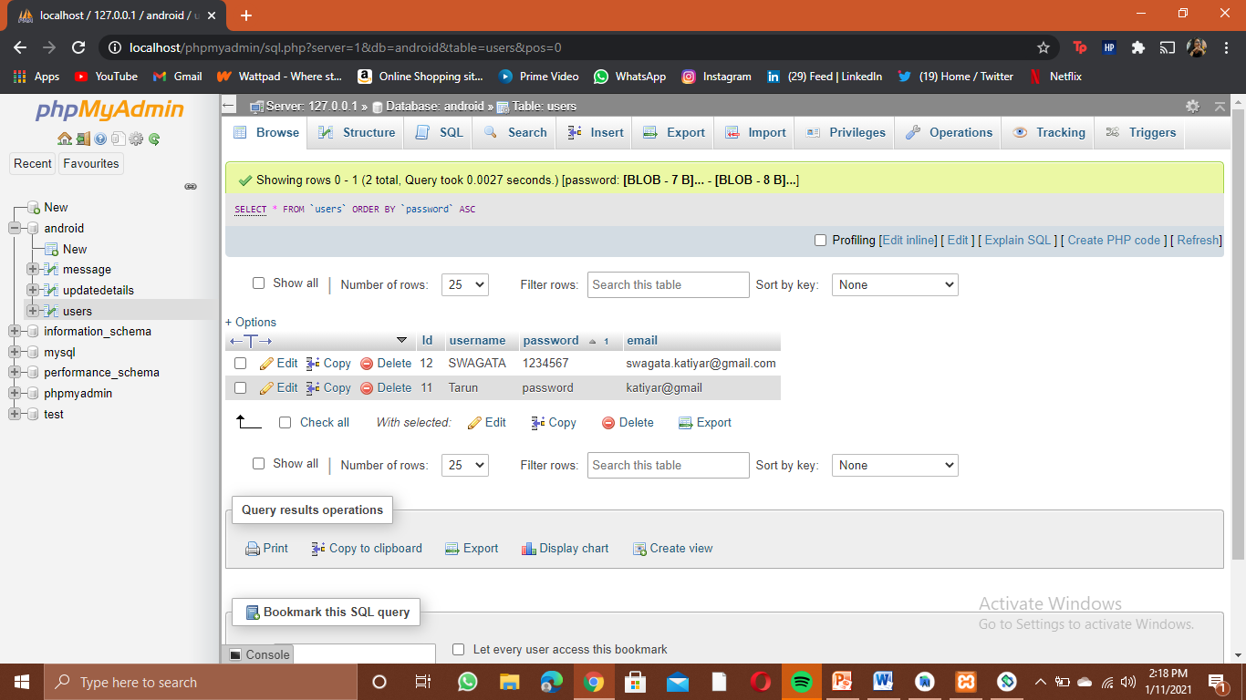
Centralized Database Storage from Android Studio

Slide 10
CONCLUSIONS
Nowadays, people go online stores through their personal computers or mobile device to avoid the frustration and exhaustion. The online brochure management system helps you overcome all the problems faced by people during offline shopping.
Furthermore, this project investigates non-functional aspects including extendibility, future scope, and usability. Overall, the project presents a comprehensive brochure management in the new developing mobile platform.

Slide 11


